Slide 1
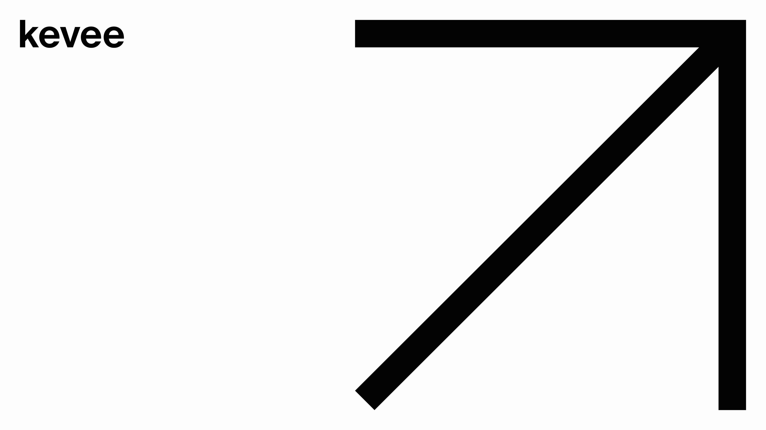
March 2024, Kuladeep Karimpati
Cloud Data Architecture

Slide 2

Could Data Architecture
–
March
2024

Slide 3
Inhalt:
Was haben wir jetzt?
Was ist neu?
Warum?
Wie es funktioniert?

Slide 4
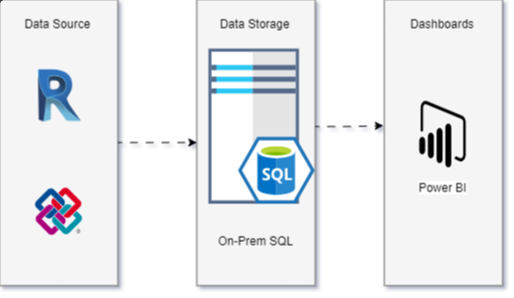
Was haben wir jetzt?
Currently, we have an on-prem data architecture model
Extract data from BIM360 models
Store the data into an SQL database in a virtual server or Local computer
Load the data into Power BI for dashboards
Transform the data and prepare charts
Architecture diagram

Slide 5
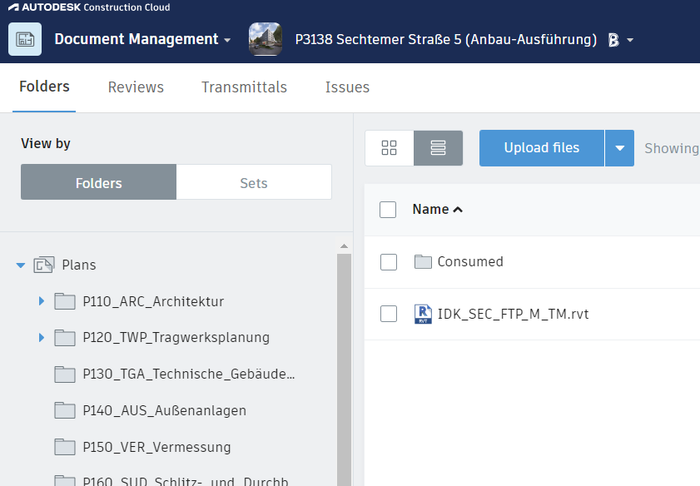
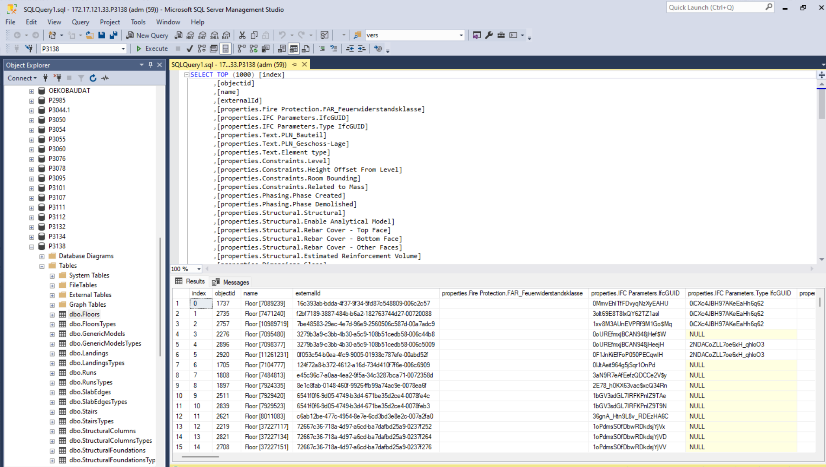
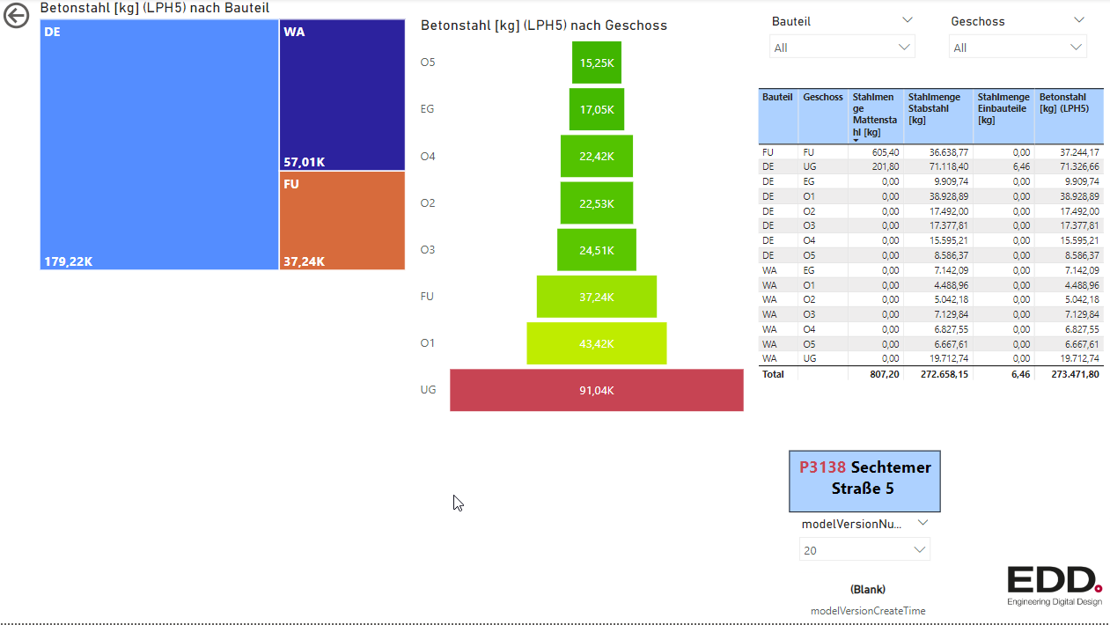
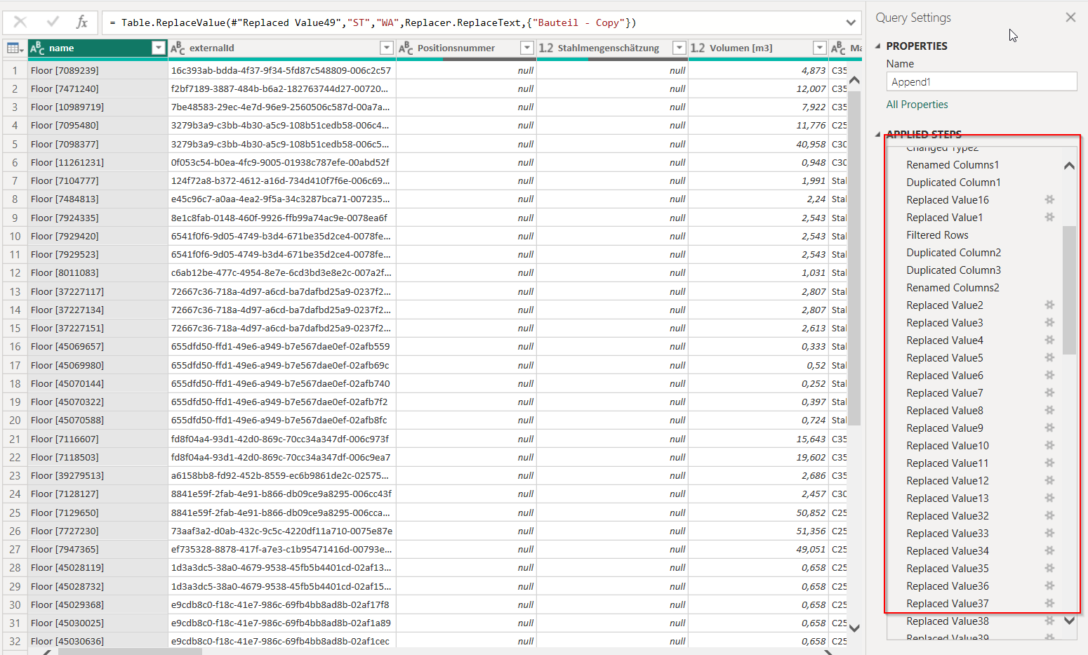
Extract
Transform
Load

Slide 6
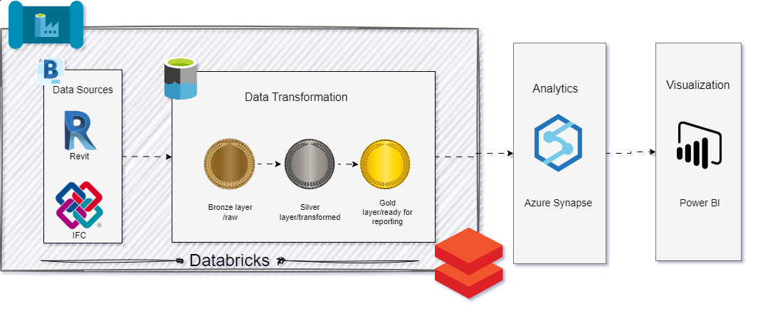
Was ist neu lösung?
A Cloud (Azure) based end to end data model
Architecture diagram

Slide 7

Warum?

Slide 8

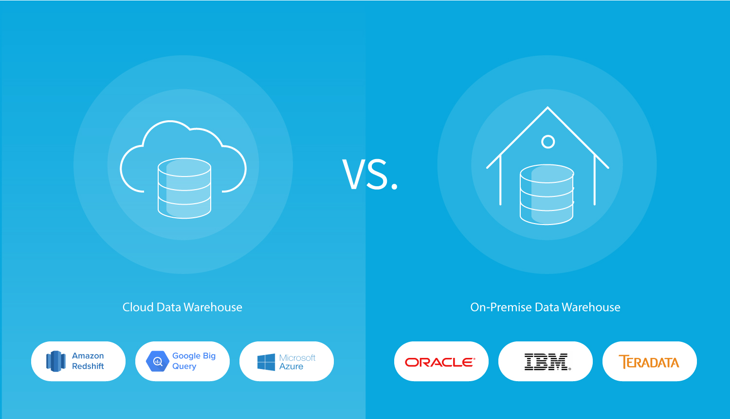
Comparison of On-Premises vs Cloud:
Security:
- Cloud: CSP manages security of infrastructure including data centers, networking, and physical security. Undergoes third-party audits for compliance with standards like SOC 2, ISO 27001, and GDPR.
- On-Premises: Security management is entirely in-house, requiring dedicated resources for infrastructure security.
Scalability:
- Cloud: Offers virtually unlimited scalability for memory and storage resources. Pay-as-you-go or subscription-based pricing allows organizations to scale resources as needed.
- On-Premises: Limited scalability based on physical hardware constraints. Expansion requires upfront investment in hardware.
Automation:
- Cloud: Provides numerous APIs for automation, allowing processes to be triggered on schedule or by events such as incoming emails.
- On-Premises: Automation capabilities may be limited, requiring manual intervention for many tasks.

Slide 9
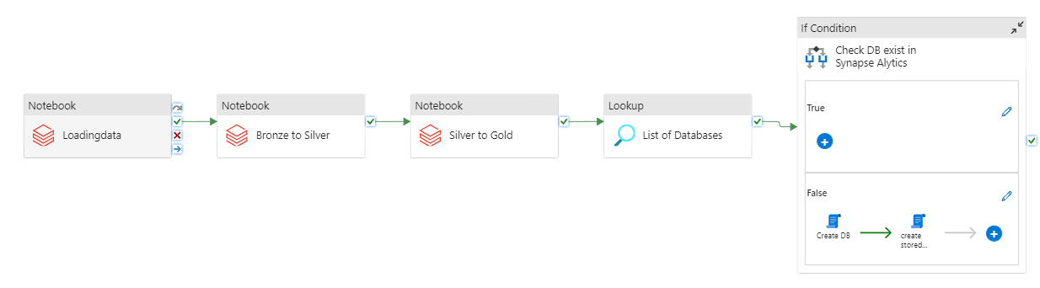
Wie es funktioniert?
Pipeline

Slide 10



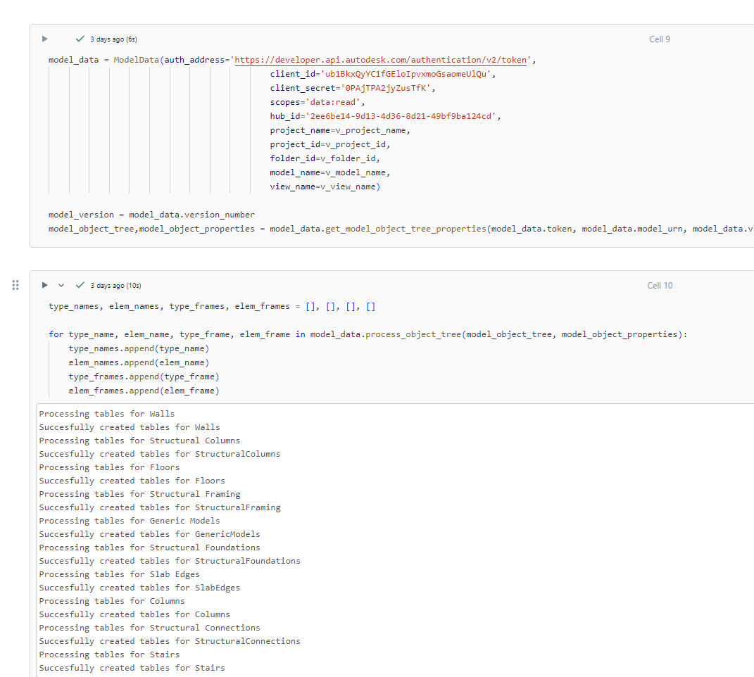
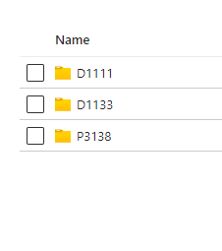
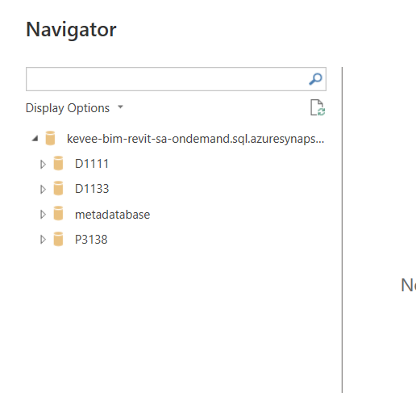
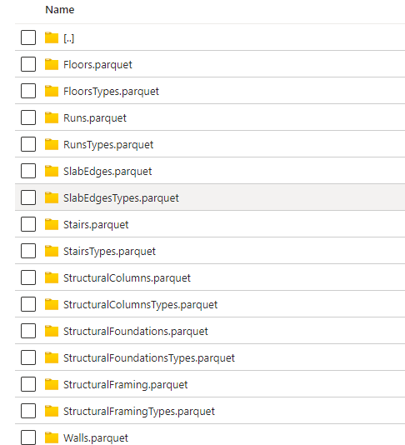
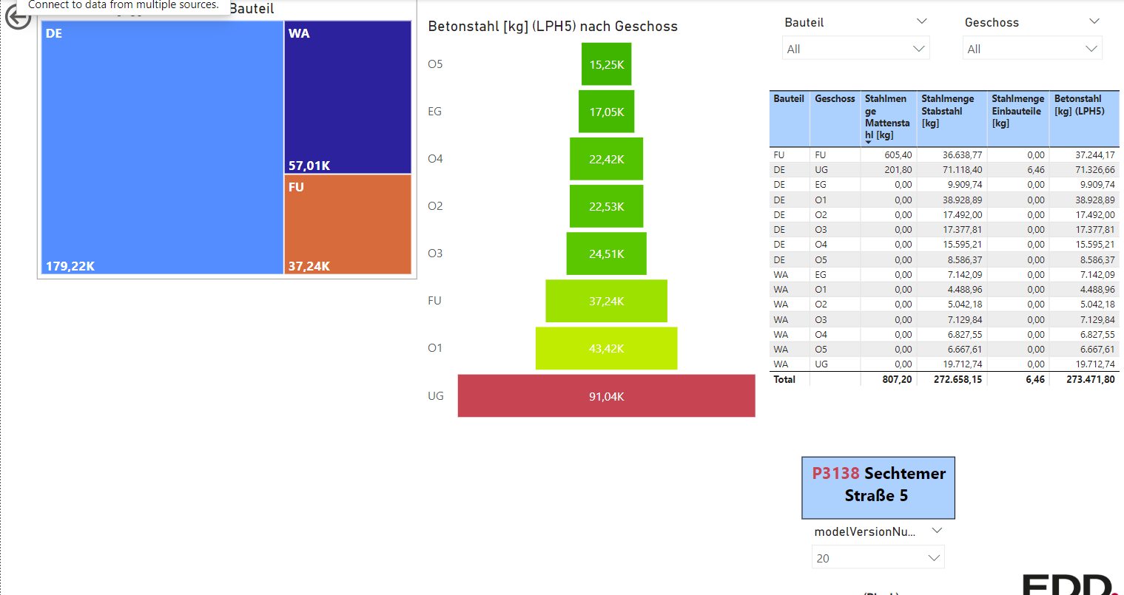
Extracted and Transformed by databricks
Data stored in Deltalake containers
Dashboards prepared in PowerBI

Slide 11

Dankeschön!

